Slide 1
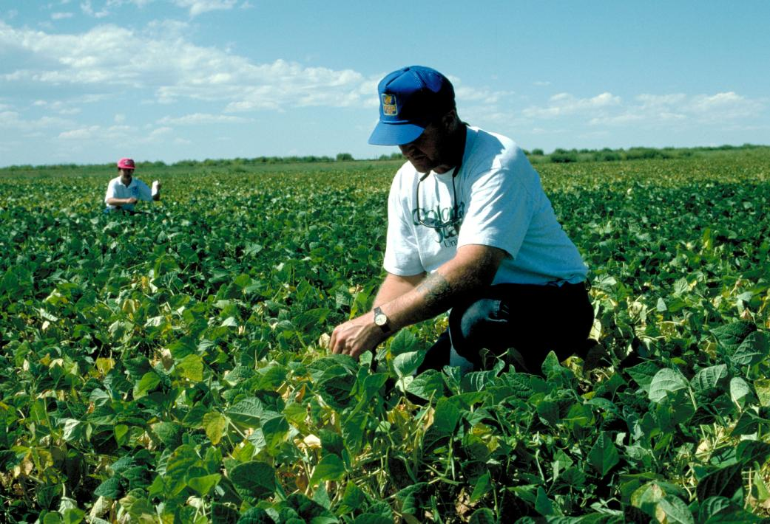
BEAN PRODUCTION – Crop Health
Howard Schwartz
Plant Pathologist
Colorado State University

Slide 2
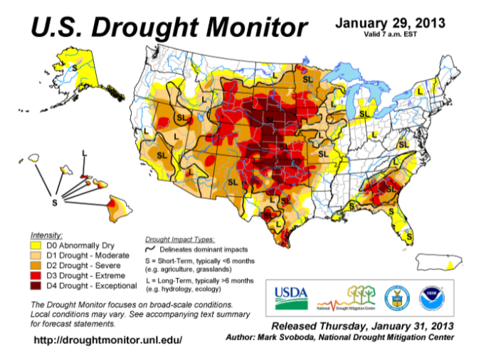
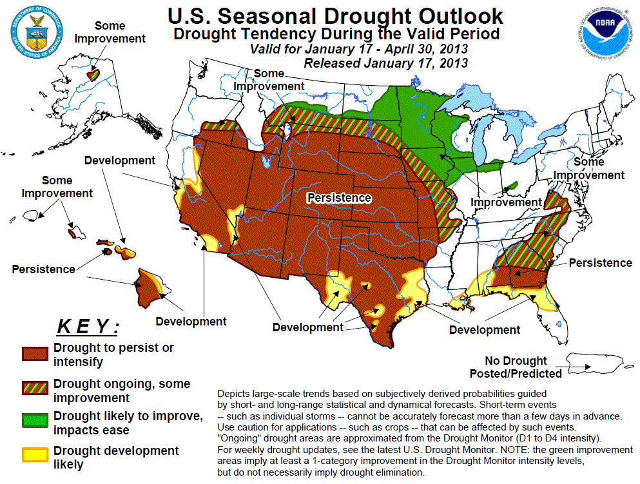
2014
??

Slide 3
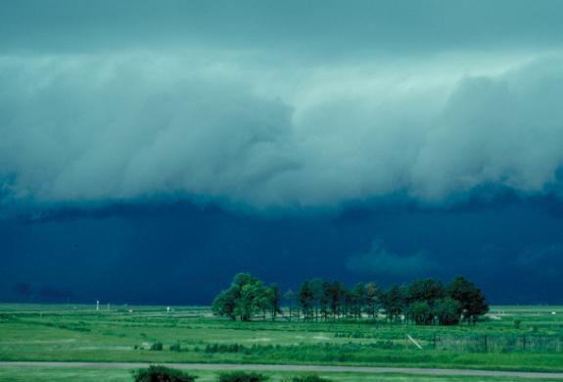
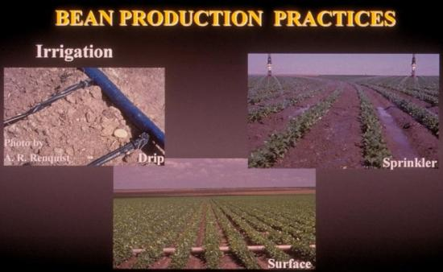
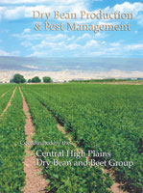
“When faced with a limited supply of water, it is best to avoid water stress EARLY in the season.
Instead, allow any stress to occur at the END of the season.”
Excerpts from Dry Bean Production & Pest Management Bull. 562A (5 year study)

Slide 4
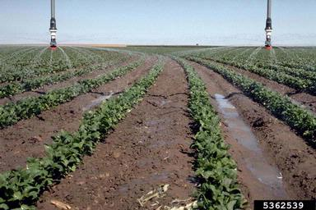
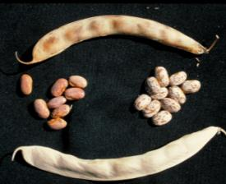
Center Pivot - Water Stress
1 or 2 week delay early, 50% or 0 rate after Aug 10
% Loss vs no stress
Delayed Maturity

Slide 5
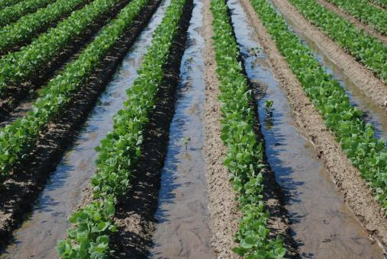
Furrow - Water Stress
1 or 2 week delay early, 50% or 0 rate after Aug 10
% Loss vs no stress
Delayed Maturity

Slide 6
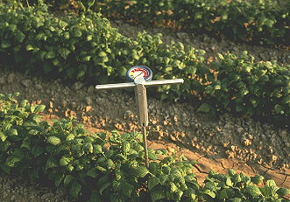
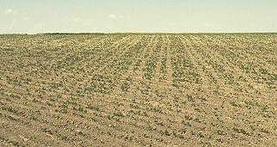
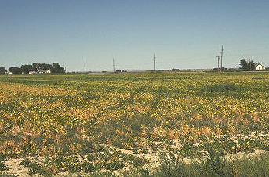
BEAN ROOT HEALTH Diagnostics – Abiotic Stress

Slide 7
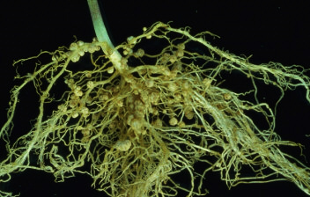
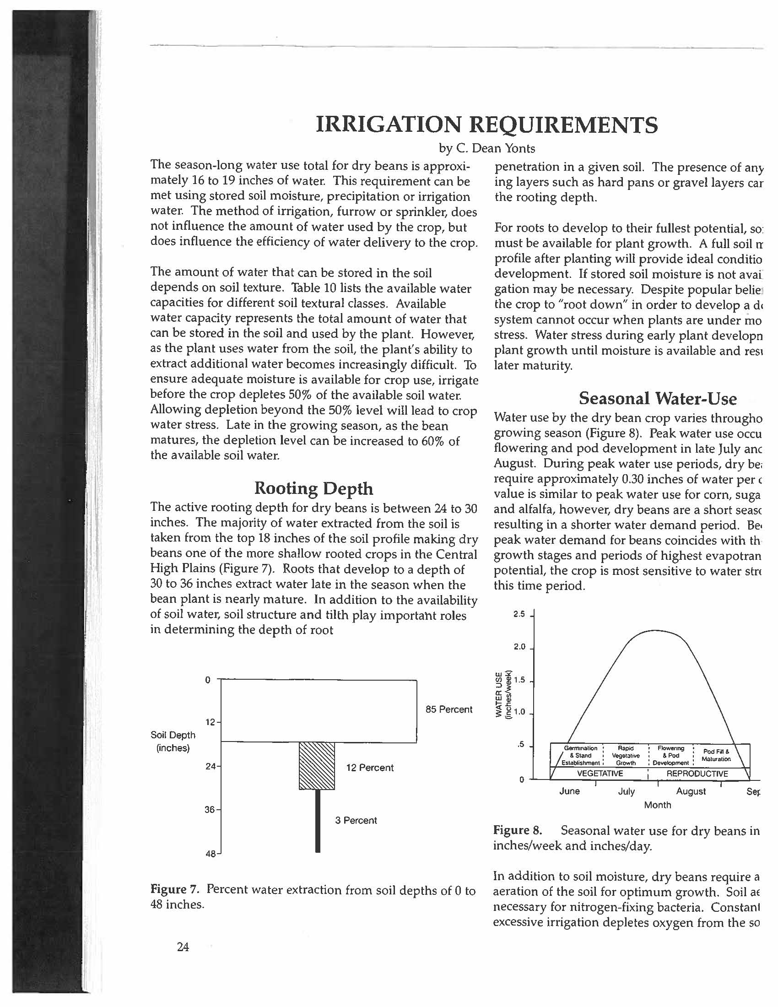
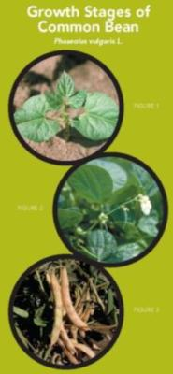
compaction zone
Bean Rooting Depth:
6 in seedlings
12 – 16 in flowering
36 in maturity
{water access critical at 24-36 in depth late season}
Excerpts from Dry Bean Production & Pest Management Bull. 562A

Slide 8
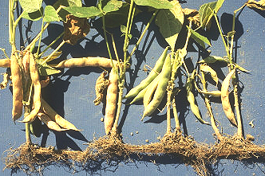
BEAN ROOT HEALTH
Soil Compaction Effects on Dry Beans
lb / A
+ 29 %
$150 / A
R. Croissant, H. Schwartz, P. Ayers
Colorado State University
Pinto 'Olathe', furrow irrigated 1987-89

Slide 9
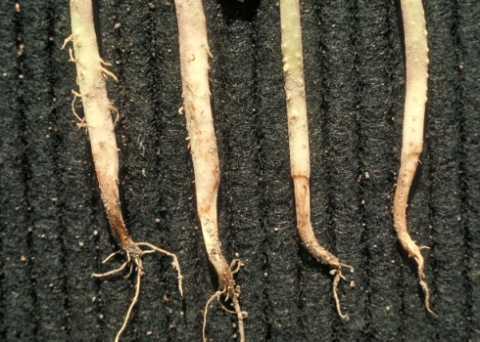
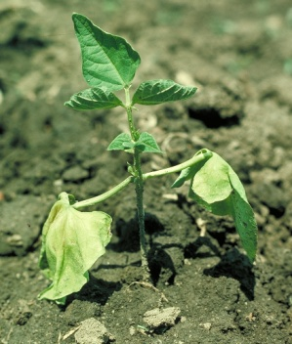
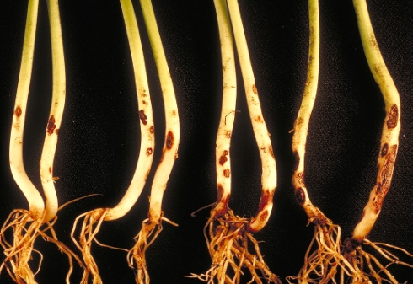
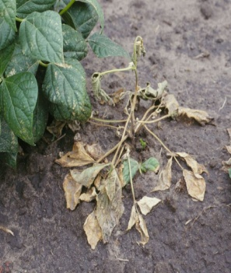
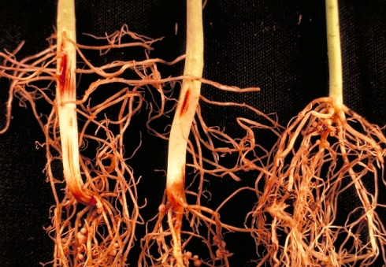
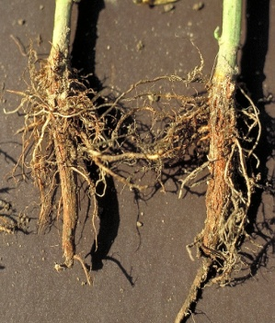
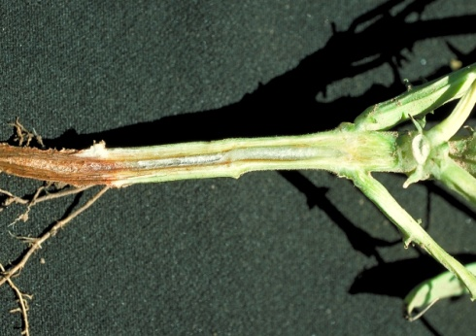
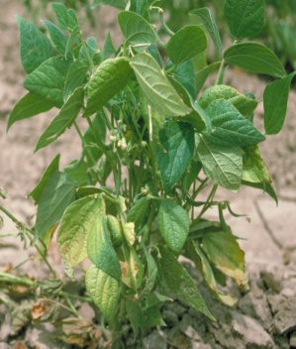
Soil-Borne Diseases of Bean
Pythium
Rhizoctonia
Fusarium RR
Fusarium Wilt

Slide 10

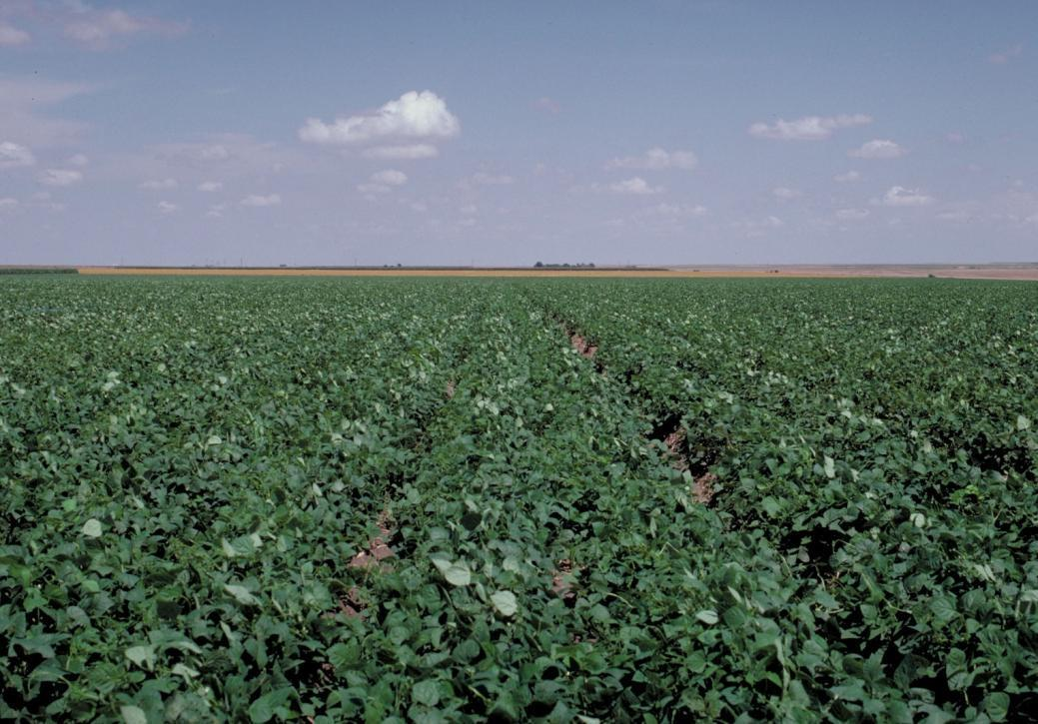
I P M Strategy – Root Rots
Effectiveness
Volunteer Management Low
Crop Rotation {3 + years} High
Variety Selection Moderate
Seed Quality Low
Planting Date {> 60ºF} High
Tillage (Sanitation) High
Irrigation Moderate
Fertility Moderate
Pesticides / Compost Moderate

Slide 11
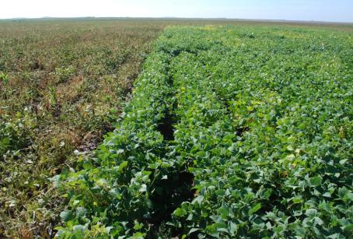
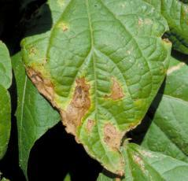
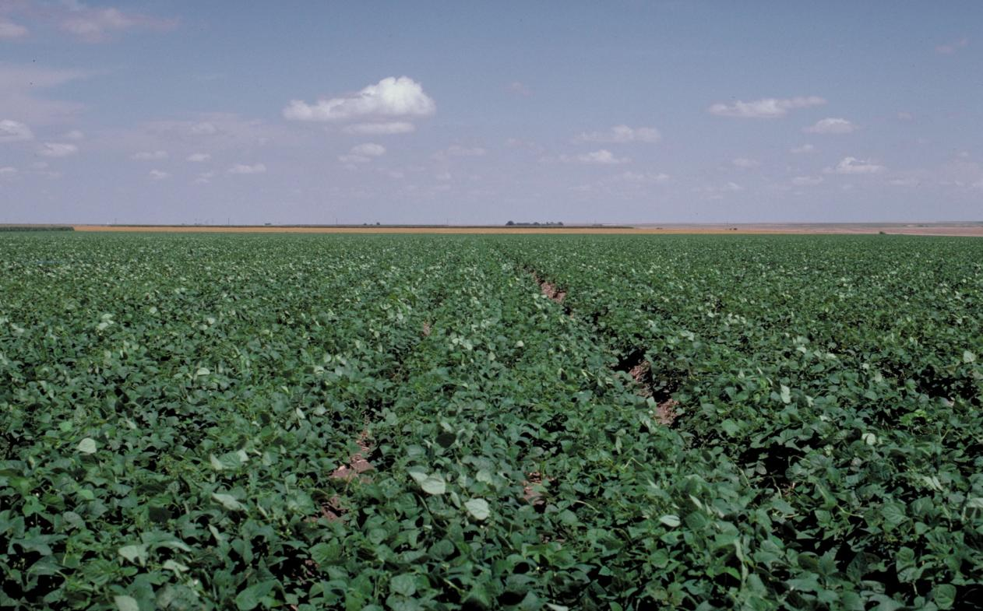
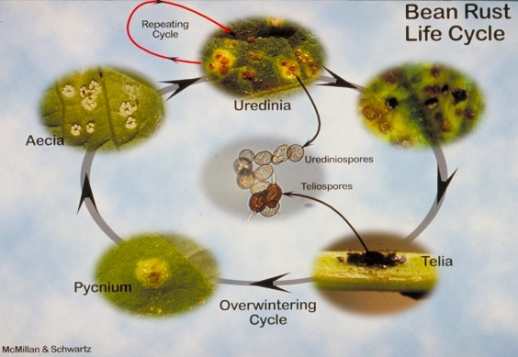
I P M Strategy –
Foliar Diseases
Effectiveness
Volunteer Management High (low for WM)
Crop Rotation {3 + years} High
Variety Selection High
Seed Quality High
Planting Date Moderate
Tillage (sanitation) Moderate to High
Irrigation Moderate (high for WM)
Fertility Moderate
Pesticide Scheduling Moderate to High

Slide 12
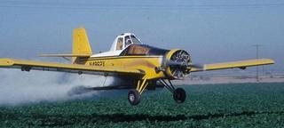
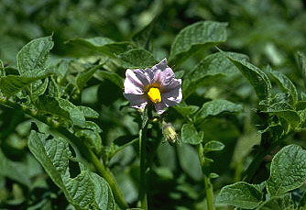
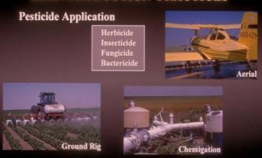

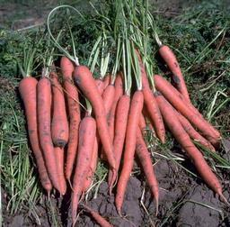
Glyphosate drift Poses a High Risk to sensitive crops grown near Roundup-treated fields
Chemical Drift Reminder !

Slide 13
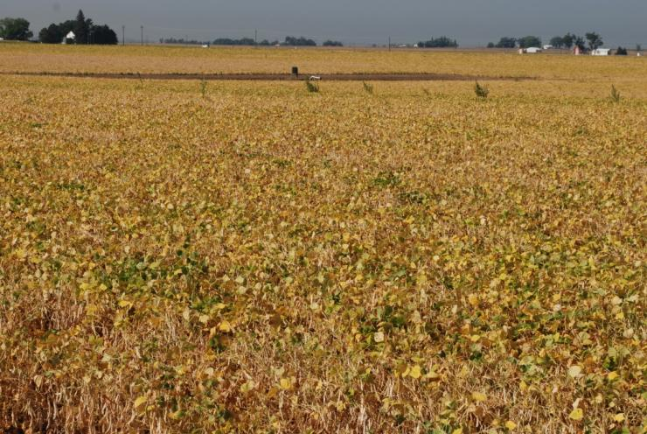
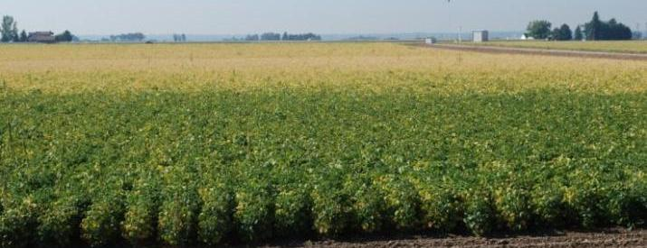
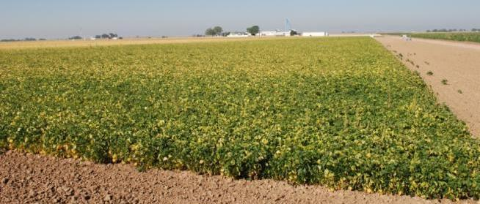
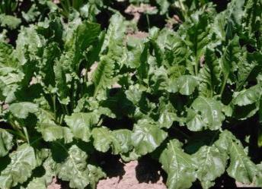
Dry Bean Damage – delayed maturity
No Drift
Drift
20 – 30 days

Slide 14
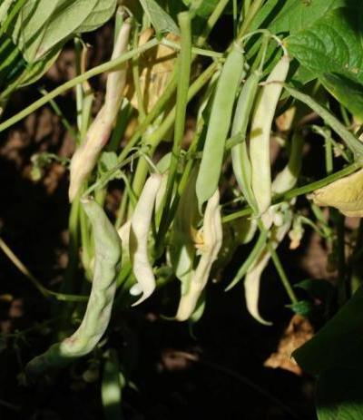
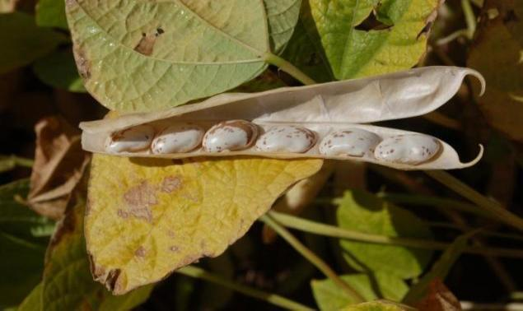
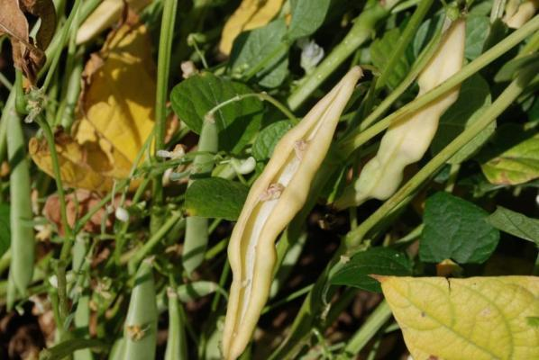
Dry Bean Damage – pod & seed responses
No Drift
Drift
30 – 100% yield loss

Slide 15
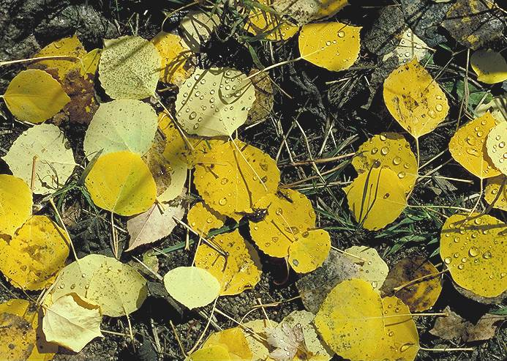

Thank you
Colorado
State
University

